Slide 1



Startup Edition
OLAWUYI RACETT NIGERIA LTD., WELLINGTON SQUARE, OXFORD, OX1 2JD, LONDON, UK RC14668218

Slide 2
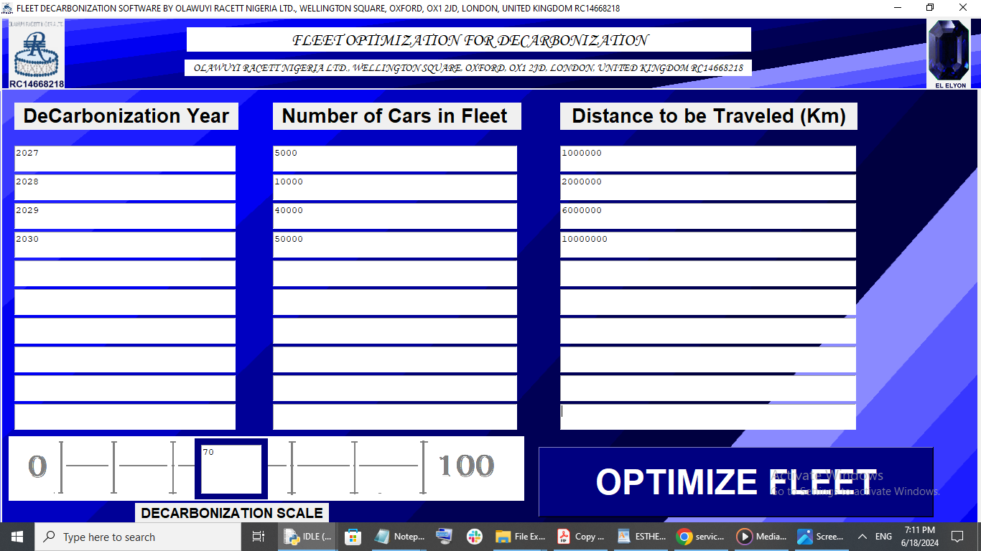
FLEET DECARBONIZATION SOFTWARE

Slide 3
FLEET DECARBONIZATION SOFTWARE
While Fleet Owners aspire to achieve Net-Zero Emissions As Soon as Possible, they also have to take into account Business Sustainability and the Increased Cost Associated with Achieving Net Zero Emissions.
We Offer a Fleet DeCarbonization Software and Mobile App for Ground Transportation Owners to be able to schedule a DeCarbonization Routine to Enable them Achieve Net Zero Emissions.
Using the Software, Existing Fleet Owners are able to select the Level of Net Zero Emissions Reduction they can realistically achieve within a Decade or So.

Slide 4
FLEET DECARBONIZATION SOFTWARE
The Software allows the Fleet Owner to
Enter in the Years they Would Like to Plan for DeCarbonization of their Ground Fleet (1-10).
Enter the Number of Cars they Would Have in their Ground Transportation for the Given Year.
Enter the Yearly Distance Demand for the Ground Fleet for Each Year.
Select the Range of DeCarbonization they Would Feel Comfortable Implementing for the Given Years.
0% - Lowest Operation Cost & Lowest Emission Reduction
100% - Highest Operation Cost & Highest Emission Reduction

Slide 5
FLEET DECARBONIZATION SOFTWARE
The Software displays for the Fleet Owner:
The Required Cost to Achieve 0% Emission Reduction.
The Required Cost to Achieve 100% Emission Reduction.
The Required Cost to Achieve the Set Percentage (%) Chosen By the Fleet Owner.

Slide 6
FLEET DECARBONIZATION SOFTWARE
This Solution allows the Fleet Owner to see:
If they can realistically afford the Emission Reduction Threshold they have selected.
If they can cost-wise afford to select a higher Emission Reduction Threshold.
To know the cost associated with Maximum Emission Reduction for their Fleet.

Slide 7
FLEET DECARBONIZATION SOFTWARE
The Software allows Fleet Owners to Optimize Fleet Emission Reduction for their Fleet PER DECADE, taking into account:
Cost
Customer Demand and Satisfaction

Slide 8
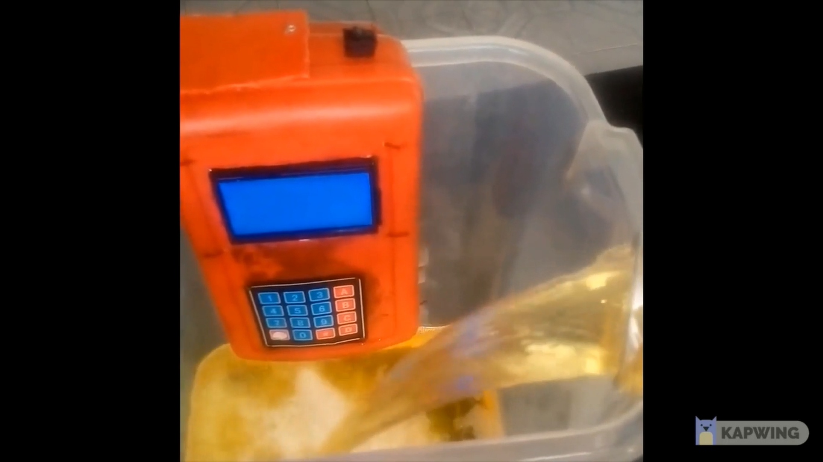
PAST EXPERIENCE WITH CUSTOMERS
Olawuyi Racett Nigeria Ltd. OX1 2JD, has worked on Optimizing Volume Measurements in the Oil and Gas Industry.
We have Designed a Novel Innovative Method called PePVEAT that provides a Technological Replacement for the Manual Tank-Dip Methods used in the Oil and Gas Industry to perform Volume Measurements of Petroleum Products.

Slide 9
PAST EXPERIENCE WITH CUSTOMERS
Olawuyi Racett Nigeria Ltd. OX1 2JD, has worked on Optimizing Volume Measurements in the Oil and Gas Industry.
We have Designed a Novel Innovative Method called PePVEAT that provides a Technological Replacement for the Manual Tank-Dip Methods used in the Oil and Gas Industry to perform Volume Measurements of Petroleum Products.

Slide 10
TECHNOLOGY STAGE
The Fleet Optimization Software owned by OLAWUYI RACETT NIGERIA LTD. OX1 2JD, is currently at the Level TRL 3 Stage.
This is because We Have Fully developed the Mathematical and Software Algorithm to Calculate and Display the Maximum Emission Reduction and Cost, as well as the Minimum Emission Reduction and Cost for a User-Defined Number of Years, Fleet Size, and Distance Demand.

Slide 11
TECHNOLOGY OVERVIEW
ALGORITHMS TO BE LEVERAGED:
LONG-TERM PLANNING, ANALYSIS AND OPTIMIZATION (A DECADE AT A TIME)
LINEAR RELATIONSHIP BETWEEN COST OF DECARBONIZATION AND REDUCTION OF CARBON EMISSION
SELECTION OF OPTIMIZED DECARBONIZATION THRESHOLD USING A CUSTOM-DESIGNED DECARBONIZATION SCALE

Slide 12
INNOVATIVE OPTIMIZATION ALGORITHM
For (N=1; N <= 10; N++):
{
Car_Cost_Per_Year_for_Available_Cars = Car_Purchase_Cost + Insurance_Cost + Maintenance_Cost
Car_Operation_Cost_Demand_Per_Year_for_Available_Cars = Distance_Demand_Per_Year * Fuel_Consumption * Cost_Per_Unit_Fuel
Car_CO2_Emission_Per_Year_for_Available_Cars = Distance_Demand_Per_Year * CO2_Emissions_Per_Unit_Fuel *

Slide 13
INNOVATIVE OPTIMIZATION ALGORITHM
Lowest_Car_Cost_Per_Year = Min(Car_Cost_Per_Year_for_Available_Cars + Car_Operation_Cost_Per_Year_for_Available_Cars)
Highest_Car_cost_Per_Year = Max(Car_Cost_Per_Year_for_Available_Cars + Car_Operation_Cost_Demand_Per_Year_for_Available_Cars)
Highest_Emission_Reduction_Per_Year = Min(Car_CO2_Emission_Per_Year_for_Available_Cars)
Lowest_Emission_Reduction_Per_Year = Max(Car_CO2_Emission_Per_Year_for_Available_Cars)

Slide 14
INNOVATIVE OPTIMIZATION ALGORITHM
Lowest_DeCarbonization = Lowest_Emission_Reduction_Per_Year (0%)
Highest_DeCarbonization = Highest_Emission_Reduction_Per_Year (100%)
Fleet_Owner_DeCarbonization_Scale_Selection = x
Fleet_Owner_Car_Cost_Per_Year = (x/100) * Highest_Car_Cost_Per_Year
Fleet_Owner_Emission_Reduction_Per_Year = (x/100) * Highest_DeCarbonization
}

Slide 15
FACTORS TO CONSIDER FOR SOLUTION
FLEET DATA FROM REPUTABLE SOURCES, INCLUDING THE FOLLOWING:
A. COMPREHENSIVE LIST OF THE TYPES AND SIZES OF VEHICLES IN FLEET
B. THE FUEL CONSUMPTION PER KM TRAVELLED FOR EACH VEHICLE
C. THE UNIT COST OF ALL DIFFERENT TYPES OF FUEL AVAILABLE
D. THE CO₂ EMISSION DATA FOR EACH TYPE OF FUEL AVAILABLE

Slide 16
VISUALIZATION OF DASHBOARD
FRONT PAGE OF THE DECARBONIZATION SOFTWARE BY OLAWUYI RACETT NIGERIA LTD OX1 2JD IS ALREADY DISPLAYED ON THE FRONT SCREEN HERE

Slide 17
VISUALIZATION OF DASHBOARD
WE INTEND TO HAVE A DISPLAY OF THE RESULTS OF A FLEET DECARBONIZATION ANALYSIS READY FOR SHELL HACKATHON 2024 USING THE DECARBONIZATION SOFTWARE FOR THE SHORTLISTED CANDIDATE SECTION OR STAGE.

Slide 18
NOVELTY
DECARBONIZATION IS NOT NECESSARILY ASSOCIATED WITH REVENUE GENERATION. IN FACT, IT TENDS TO BE THE OPPOSITE IN THE SHORT RUN, AND SO PRODUCTS PRODUCED FOR DECARBONIZATION TEND TO NOT GENERATE INCOME OR REVENUE IN THE SHORT RUN.
WHILE DECARBONIZATION PRODUCTS MAY HAVE A LOT OF MERIT IN TERMS OF TECHNICAL VALUE, THEY RARELY GENERATE PROFIT.

Slide 19
NOVELTY
BY PROVIDING A DECARBONIZATION SOFTWARE THAT IS CHEAP AND READILY AVAILABLE, IT WOULD INSPIRE OPERATIONAL FLEETS TO GO THE EXTRA MILE AND SPEND A LITTLE MORE IN OPERATIONAL COSTS IN ORDER TO ACHIEVE AN INCREASE IN CARBON EMISSION REDUCTIONS.

Slide 20
INTELLECTUAL PROPERTY
WE DO NOT YET HAVE A PATENT FOR THE DECARBONIZATION SOFTWARE.
BUT AS WE FULLY DEVELOP IT IN COLLABORATION WITH SHELL, WE EXPECT AND HOPE THAT SHELL WOULD ASSIST US IN SECURING THE RIGHT PATENT FOR IT AS WE WORK WITH THEM.

Slide 21
COMPETITORS AND MARKET SIZE
CURRENT/FUTURE COMPETITORS - NONE
TOTAL ADDRESSABLE MARKET (TAM), SERVICEABLE ADDRESSABLE MARKET (SAM), & SERVICEABLE OBTAINABLE MARKET (SOM):
GROUND FLEET TRANSPORTERS. THIS INCLUDES CAR RENTAL AGENCIES, TAXI FLEETS, OIL AND GAS TANKERS TRANSPORTATION FLEETS, AND FLEETS OF METRO BUSES.

Slide 22
COMPETITORS AND MARKET SIZE
EVERY OWNER OF A FLEET ON THE GROUND HAS NEED OF THE DECARBONIZATION SOFTWARE TO HELP THEM PLAN FOR THE DECARBONIZATION ROUTE BEST FEASIBLE FOR HIS OR HER OWN COMPANY FLEET, AND TO ENCOURAGE THEM TO EXECUTE CARBON EMISSION REDUCTION ON THE GROUND.

Slide 23
FLEET DECARBONIZATION SOFTWARE

Slide 24
DECARBONIZATION SOFTWARE
OUR SOFTWARE ENABLES LONG-TERM PLANNING FOR DECARBONIZATION SCHEDULES BY OPERATIONAL FLEETS AND TRANSCENDS TO LONG-TERM COMMITMENT TO DECARBONIZATION AND MEETING NET-ZERO EMISSIONS OPTIMALLY IN THE LEAST AMOUNT OF TIME.

Slide 25
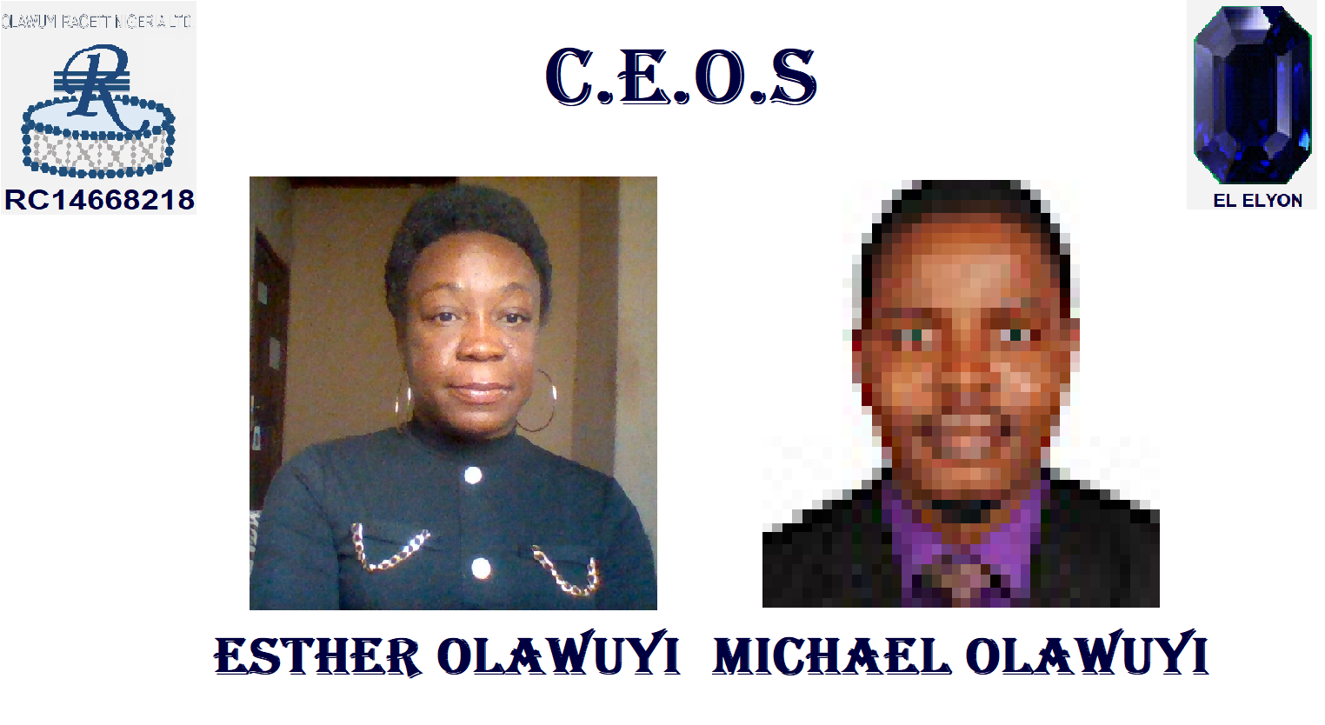
FOUNDERS AND C.E.O.s
Automating and Optimizing Volume Measurements of Oil and Gas Products (Crude Oil, Diesel, Kerosene, and Petroleum).
Determining the Quality of Oil and Gas Products at Point of Sale (POS) Terminals.
Automated Tracking of Petroleum Products During Ground Transportation in Tankers.
Pattern Recognition in Sub-Surface Pressure to Identify and Predict If a Producing or Injection Well is Flowing or Shut in, in order to Optimize Well Design, Production Rates, and Maximize Fluid Recovery from Each Well.
M.P.H., University of Aberdeen
M.B.B.S., igbinedion University,
Okada
D.Sc. George Washington University (GWU).,
M.S.E.E. and B.S.E.E., Howard University

Slide 26
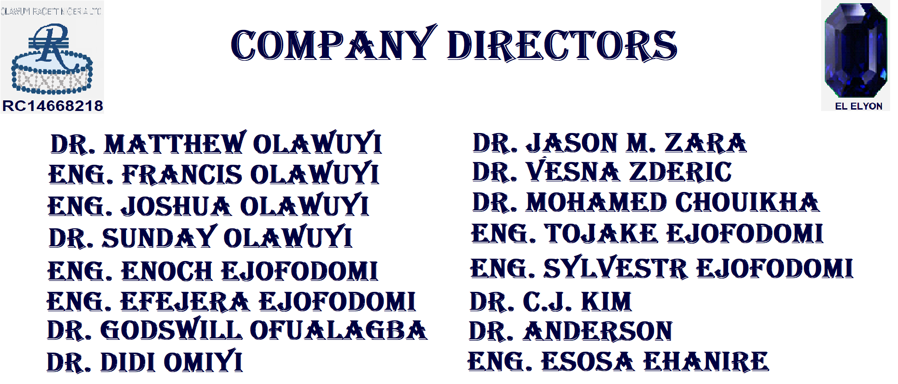
M.P.H., University of Aberdeen
M.B.B.S., igbinedion University,
Okada

Slide 27
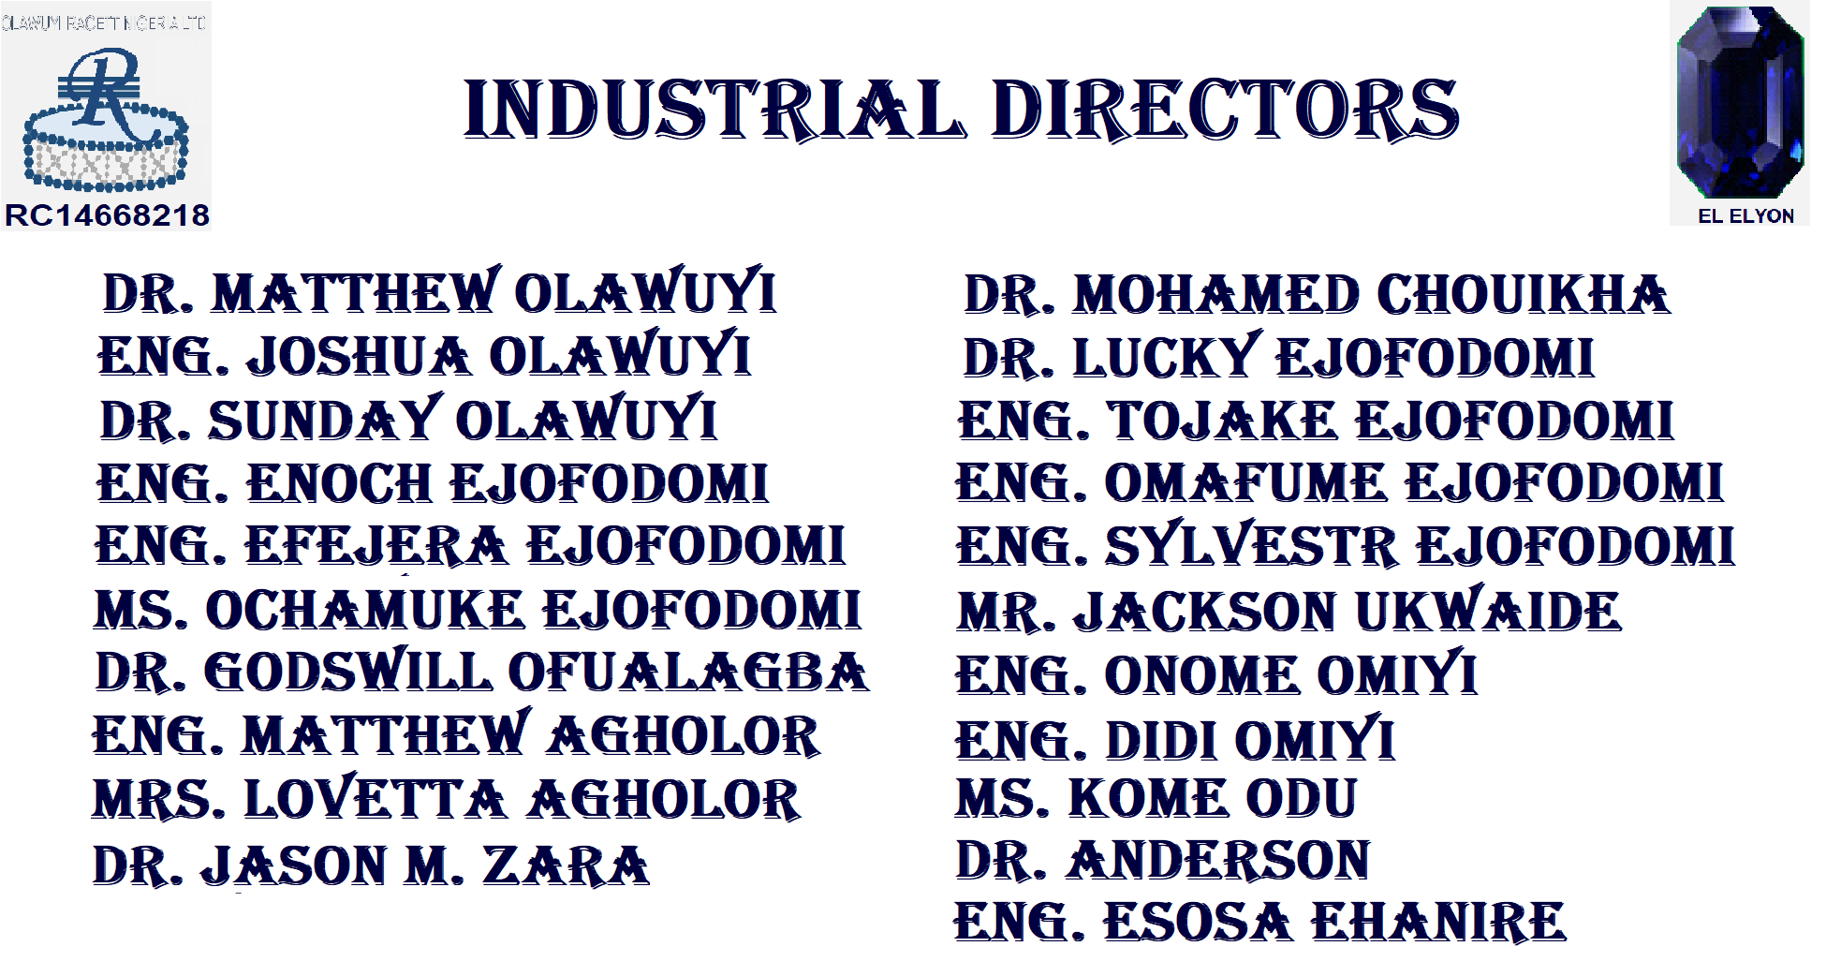

Slide 28
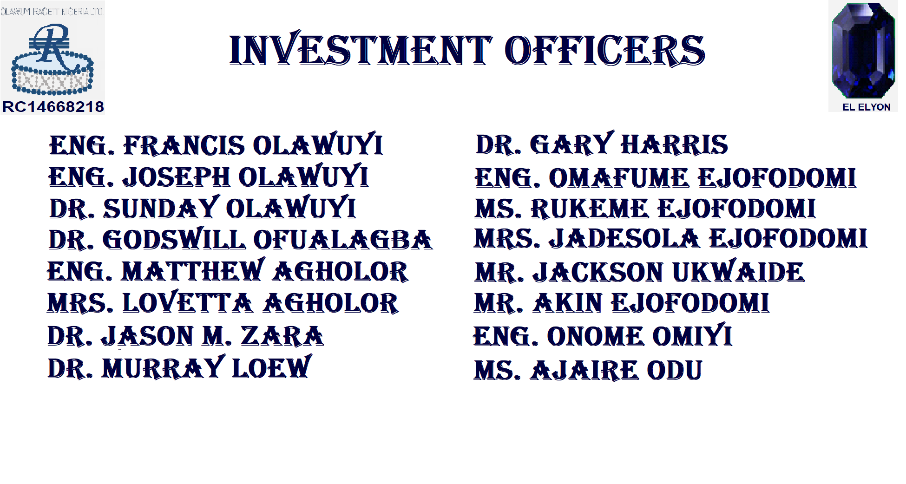

Slide 29
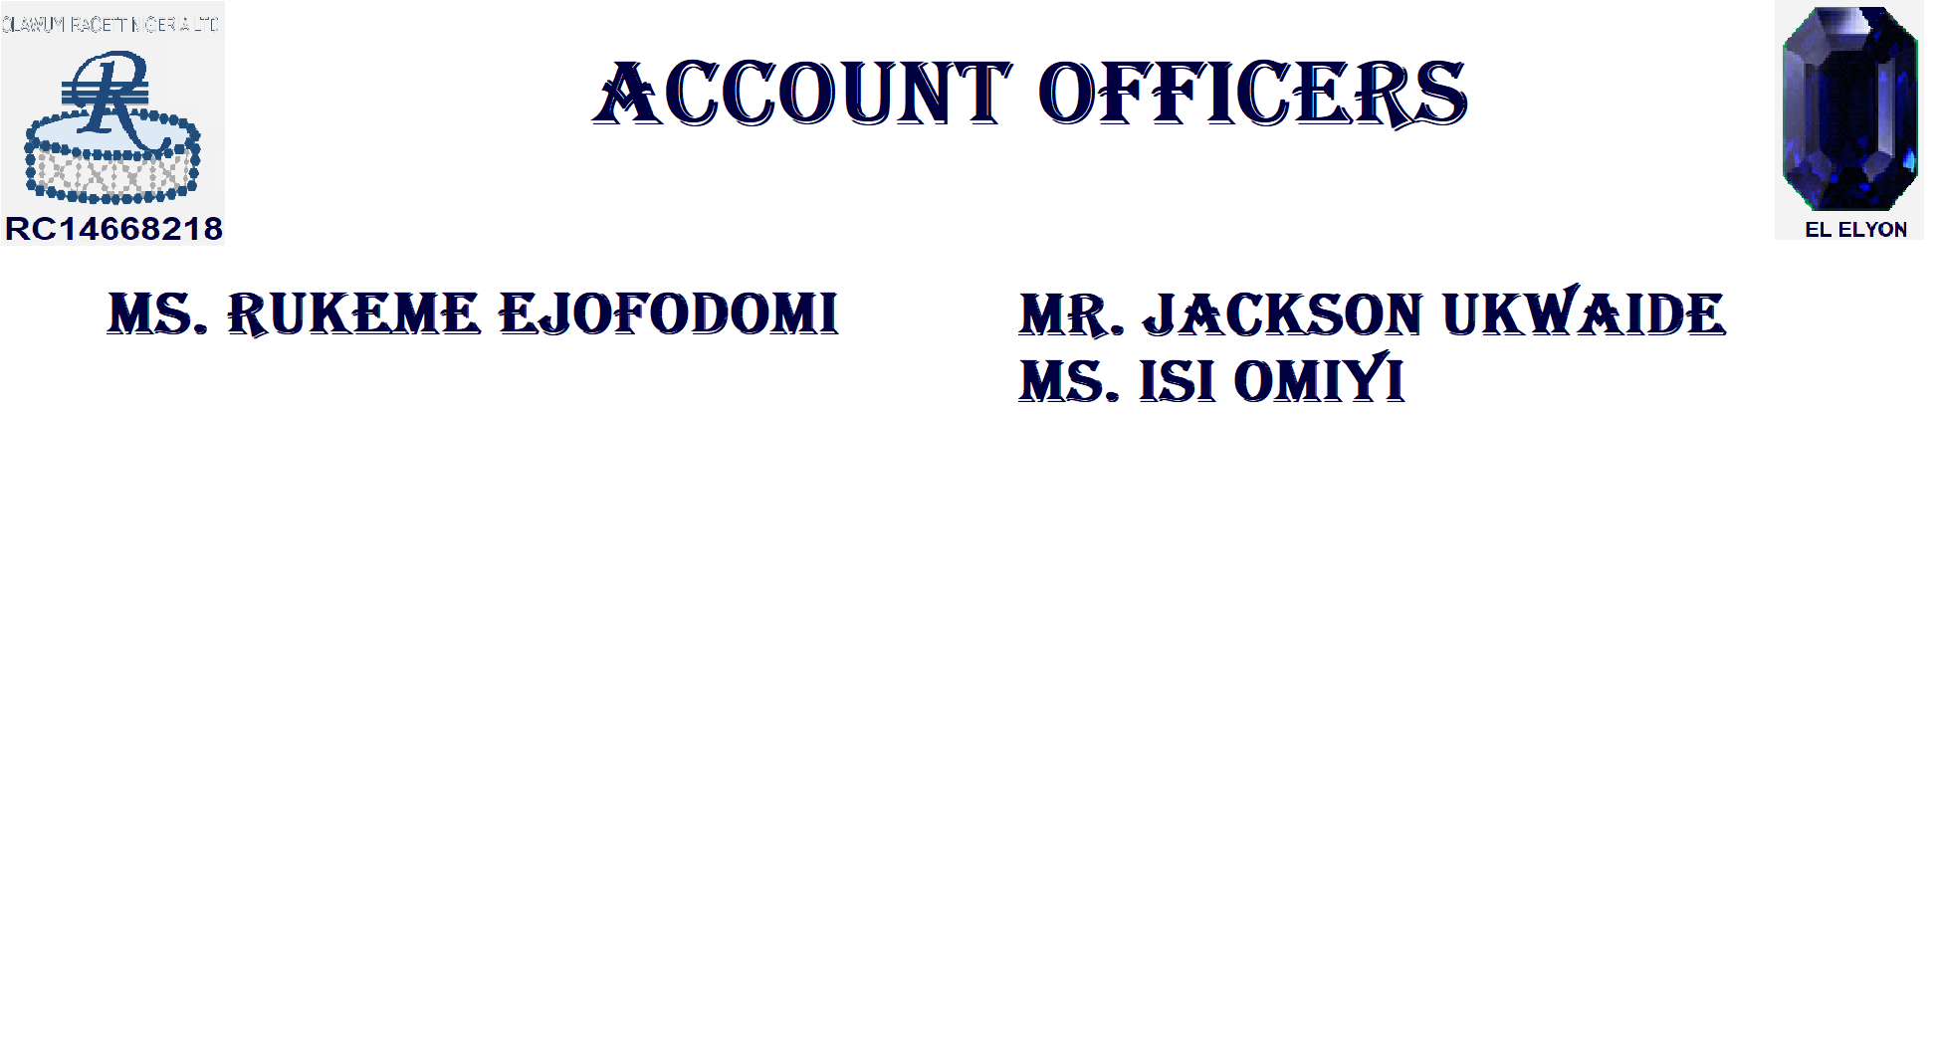

Slide 30


Slide 31

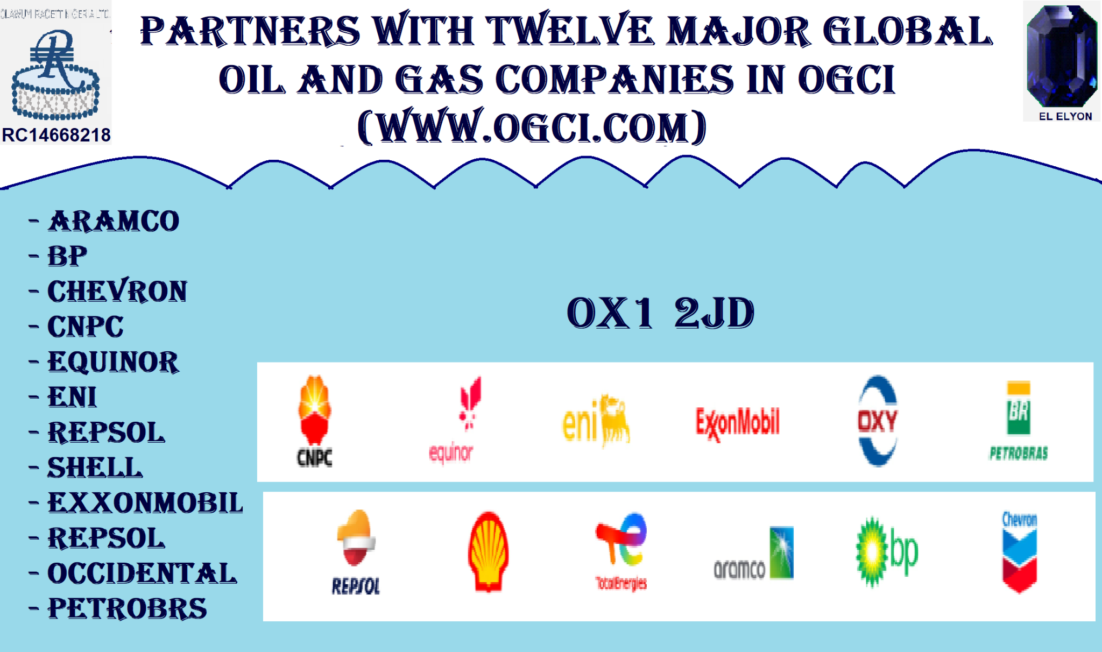
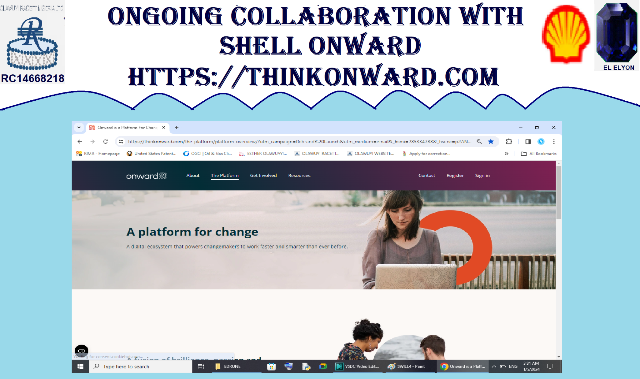
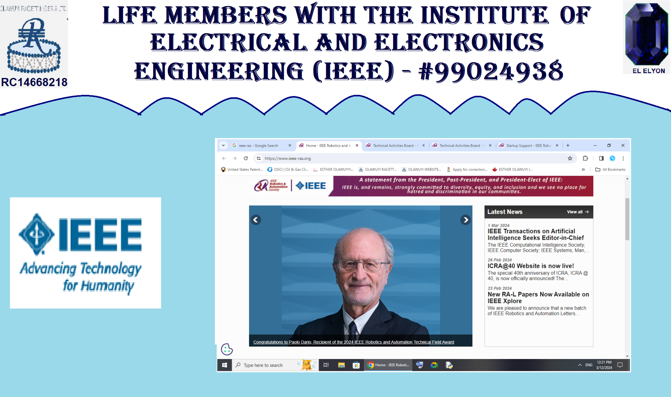
36 Pastinaak, Venray, 5803 KR, Netherlands
OLAWUYI RACETT NIGERIA LTD.
OX1 2JD, LONDON, UK RC14668218
OLAWUYI RACETT NIGERIA LTD. WELLINGTON SQUARE, OXFORD, OX1 2JD, LONDON, UNITED KINGDOM RC16668218 was formed on February 16, 2024 and is registered in United Kingdom
We operate out of United Kingdom, but we are also active in United States Canada
Strong Collaboration with Shell through Shell Onward (https://thinkonward.com/)
Permanent Collaboration with the Oil and Gas Climate Initiative (OGCI) in UK and USA (https://www.ogci.com)
Life Members with the Institute of Electrical and Electronics Engineers (IEEE) in USA (https://www.ieee.org).

Slide 32



